Slide 1

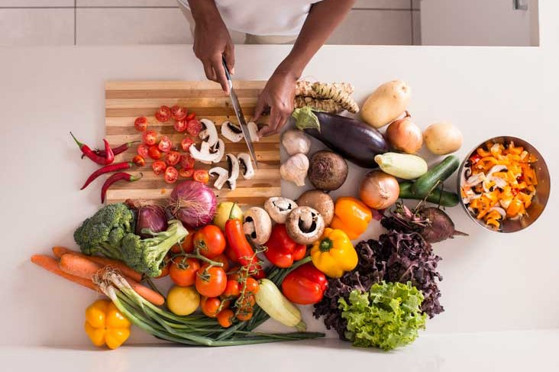
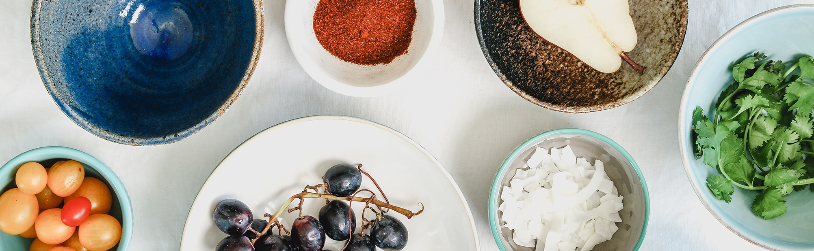
PROMOTING HEALTHY EATING & BALANCED DIET
with Re-Define Me
Professor: Henry Wong
Computer Science Project
Course : CS692
Team: 2 (Tiny Coders)

Slide 2
AGENDA
Improvements from professor feedback
Team Members
Problem Statement
Project Description
Personas
Minimal Viable Product (MVP)
Technologies
Architecture Diagram
Sprint 3 Recap
Product Backlog
Sprint Backlog
Metrics
Retrospective​
Sprint 5
Project Demo
Application Demo
Git-hub link
Live Application Demo

Slide 3

Meet the team
MEET THE TEAM
Sathwik Mudenti
Varun Reddy
Naresh Babu Chinta
BACKEND DEVELOPER 1
BACKEND DEVELOPER 2
QA/TESTER

Slide 4
Meet the team
MEET THE TEAM
Dharini Maanasa
Brunda Reddy
FRONTEND DEVELOPER
DBA

Slide 5


PROFESSOR FEEDBACK
Improvements Made
Professor feedback
Professor suggested us to add components to the Architecture diagram
Our MVP was not clear and concise.
User stories and acceptance criteria was misunderstood
Change the animated images.
Change Personas.
Proper explanation of problem statement and project description.
We Updated our Architecture diagram.
We Focused on the things that are to be included as part of our MVP.
We made changes in user stories and acceptance criteria.
We have added ER diagram and made changes in TVC and Burndown Chart.
Clear explanation of the technologies.

Slide 6

TEAM
AGREEMENT

Slide 7

TEAM AGREEMENT
We makes sure team has clear objectives of the project.
Make a list of all the tasks that need to be completed.
Being engaged and stay committed to submit deliverables on time.
Encouraging each other to complete the tasks given.
Understanding what is expected and what needs to be delivered.
Making sure every teammate providing the equal amount of contribution.
Providing the feedback within the team to perform better.
Team:
1)Maanasa Dharini
2)Sathwik Mundeti
3)Naresh Babu Chinta
4)Varun Reddy Duggimpudi
5)Brunda Reddy

Slide 8
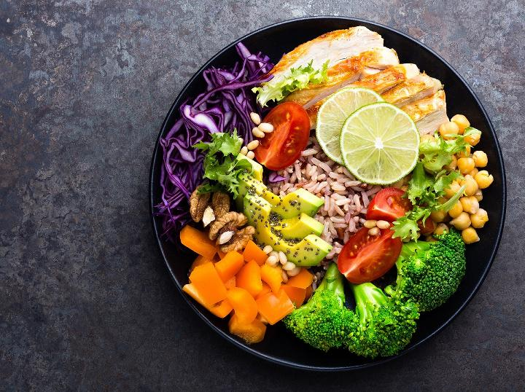
PROBLEM STATEMENT

Slide 9
PROBLEM STATEMENT
A health casual who doesn't particularly care about calorie counting needs a way to get a good idea of how (healthily?) they're eating, because the other food tracking apps are too labor-intensive to use regularly or focus too much on metrics.
Food classification is a challenging problem due to the large number of food categories. Calorie estimation that helps in calculating number of calories in a recipe, food classification that brings out ingredients in a recipe, maintenance calories that help in calculating number of calories based on age, height and activity and recipe generation that helps us to create recipe from the set of inputs that we give are part of our project.

Slide 10
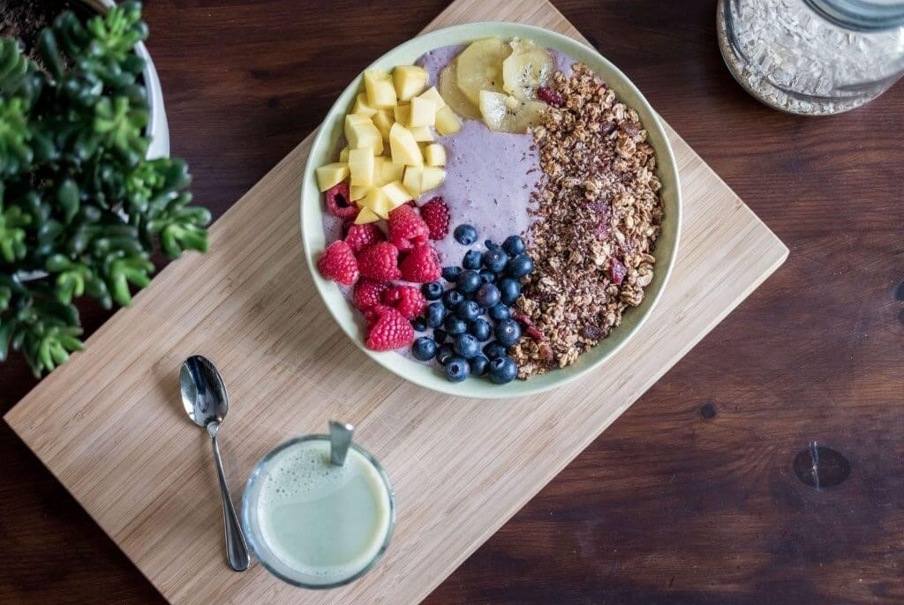
PROJECT DESCRIPTION

Slide 11
Project description
Project Title | Promoting healthy eating and balanced diet with Re-Define Me.
Team | 2 Tiny Coders.
Brief Description | We are providing the customers a healthy living habits with proper nutrients and workouts with unique features according to the user customization.
How does it help the user | We provide the details of the dietitian, personal trainers, nutrients and the gyms nearby once the user register/subscribe.
Git-hub Link: | https://github.com/DhariniMansi/CS691.wiki.git

Slide 12
Project description
We want to provide a digital health and wellness web application designed to help users shed the pounds and get active, Nutrition Tracker, Water Tracker, Workout and Weight Tracker.
Operating from a freemium model, the platform offers users the opportunity to monitor and track their daily calorie intake, get personalized advice from a team of professionally qualified nutritionists and fitness experts and suggest proper diet flow to the user.
Using deep learning techniques, we are trying to implement all these features into our application.

Slide 13
FEATURES
The project focuses on four major problem statements:
Food Classification.
Recipe Generation.
Balanced Diet.
Calorie Estimation.

Slide 14
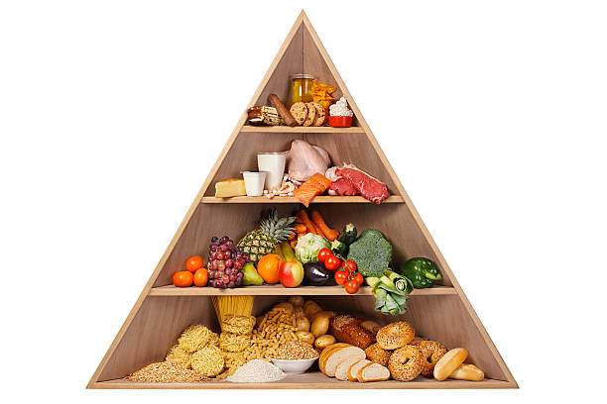
FOOD CLASSIFICATION
Food can be defined as any processed, semi-processed or raw product that is destined for human consumption.
Processed foods have these elements in different compositions in order to give them textures, flavor, color and nutritional value.
As for the solid elements that food contains, they are lipids, proteins, carbohydrates and their derivatives.
It’s multi-class classification problem to predict the 251 fine-grained food-categories.

Slide 15

RECIPE GENERATION
Our design predicts ingredients as sets by means of a novel architecture, modeling their dependencies without imposing any order, and then generates cooking instructions by attending to both image and its inferred ingredients simultaneously.
Interests in the automatic generation of cooking recipes have been growing steadily over the past few years thanks to a large amount of online cooking recipes.

Slide 16
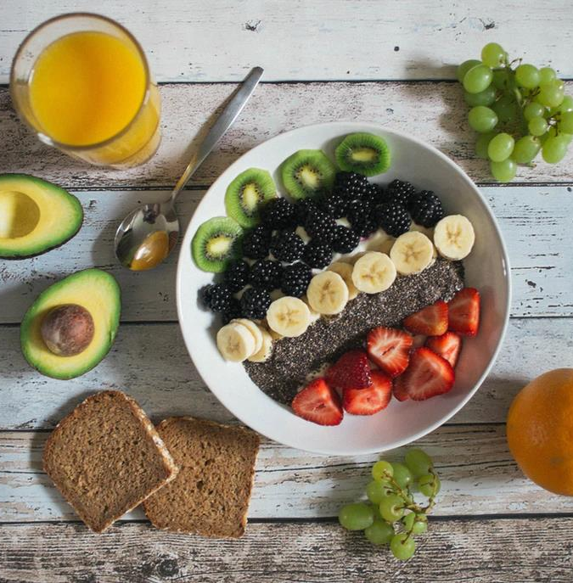
BALANCED DIET
A balanced diet integrates daily consumption of all food groups.
Dieting is the practice of eating food in a regulated way to decrease, maintain, or increase weight, or to prevent and treat diseases such as diabetes & obesity.
As weight loss depends on calorie intake, different kinds of calorie-reduced diet, emphasizing macronutrients.
Example: Low-fat, Low-carbohydrate, etc.

Slide 17
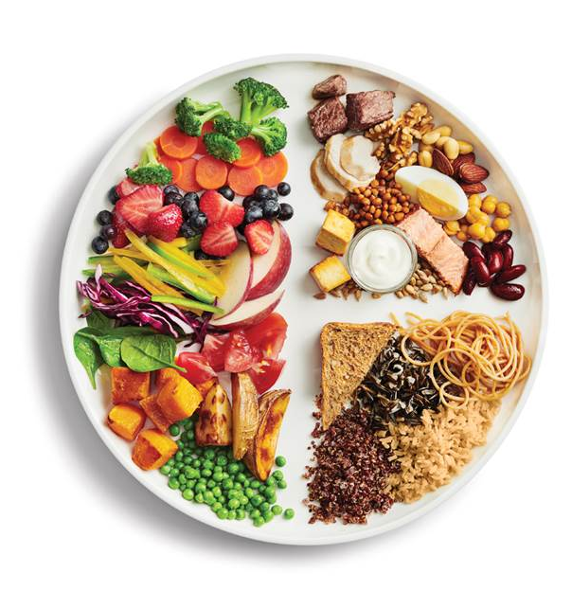
CALORIE ESTIMATION
A balanced diet is one that contains all the essential elements that the human body needs.
Carbohydrates, lipids, vitamins, minerals, proteins, fiber and water are all essential components in a well-balanced diet.
A nutritious, well-balanced diet lowers the risk of disease and enhances general health.
Formula to estimate calories - 0.24((fat * 37) + (protein*17) + (sodium *8) + (sugar * 17)) = Total calories.

Slide 18
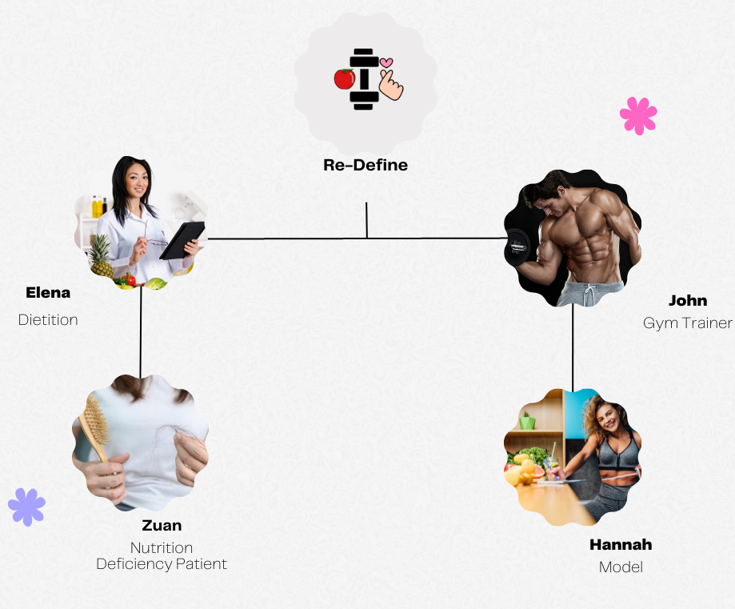
PERSONAS

Slide 19

Elena Dietitian 35 years
PROFILE
Name: Elena
Age: 32 years
Profession: Dietitian.
Graduation: She graduated with her doctorate from the University of Bridgeport School of Chiropractic.
Work Experience: She has spent over 5 years in the healthcare industry and has a patients for understanding human biomechanics and she is registered with the Commission of Dietetics Registration (CDR).
Interests: She loves long rides, cooking, Athletics and Human Performance.
Goals: Her goal is to collaborate with the top EHR system handling companies to update the EHR system and need to hire few faculty who helps her in maintaining the data of clients.

Slide 20
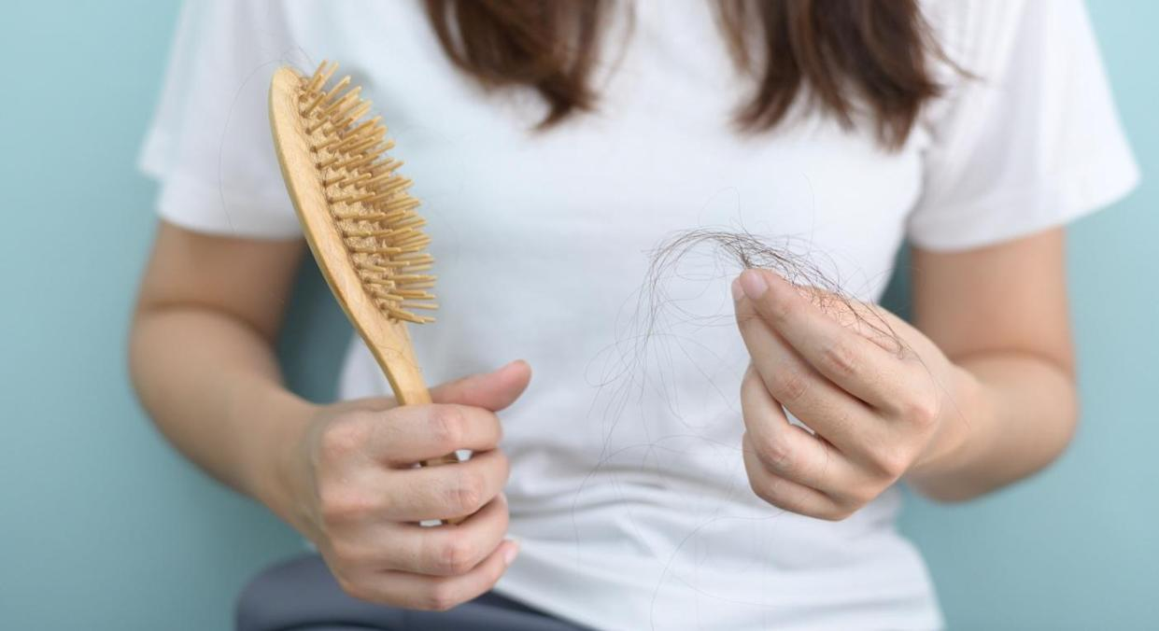
PROFILE
Name: Zuan
Age: 26 years.
Profession: Software Developer at Apple Inc.
Problem: She is suffering from Nutrition Deficiency, lactose intolerance, has signs of B12 and suffering from dry skin, severe hair fall.
Treatment: medication for malnutrition including supplementation, proper diet, lifestyle and eating disorder.
Work Pressure: It is difficult for Zuan to handle her job and the work pressure there due to hectic schedule.
Goals: As Calcium deficiency can reduce bone strength and lead to osteoporosis, which is characterized by fragile bones Zuan wants to take the supplements with food containing vitamins in order to maintain balance.

Slide 21
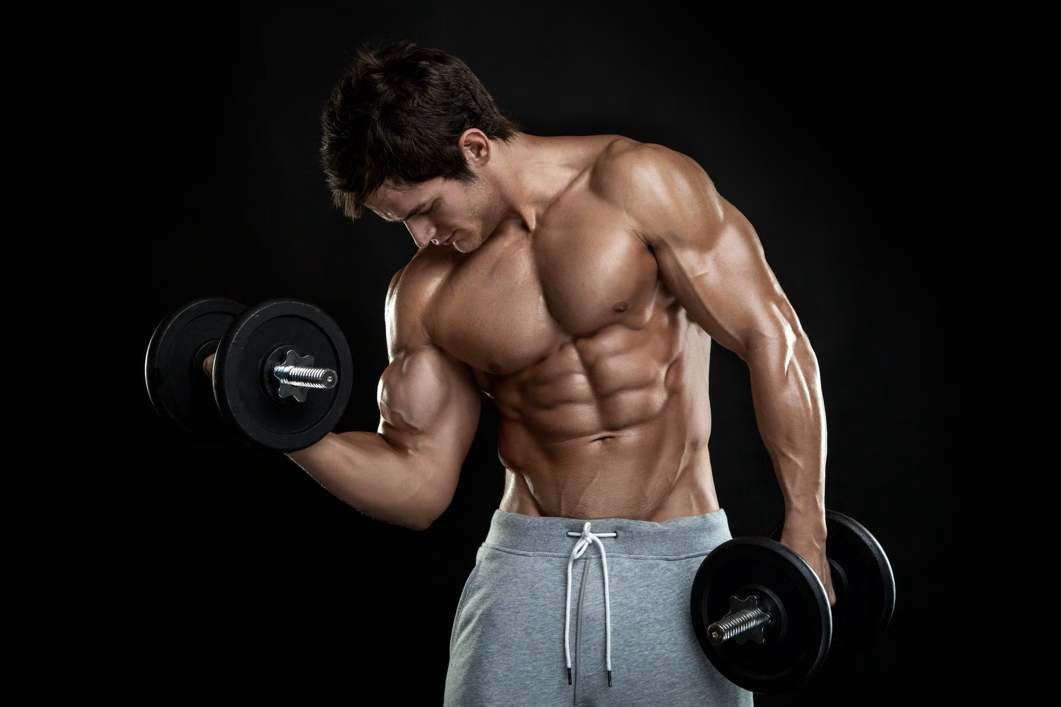
PROFILE
Name: Alex.
Age: 29.
Profession: Gym Trainer
Fitness Level/Rating: Best.
Experience: Alex is the head coach of Mighty transformation program. And his passion is to help people change their lives in the simplest and most realistic way. He believe everyone deserves the right to good health and to be happy with themselves inside and out.
Interests: Weights lifting, Dancing, Cycling, Volunteering, Hiking
Goals: Alex is mindful of what his clients eat is just as crucial as their routine, in order to bring in healthy life and health mind. He wants to become established fitness professional. He helps his client to reach their individual goals with unique diet plans.

Slide 22
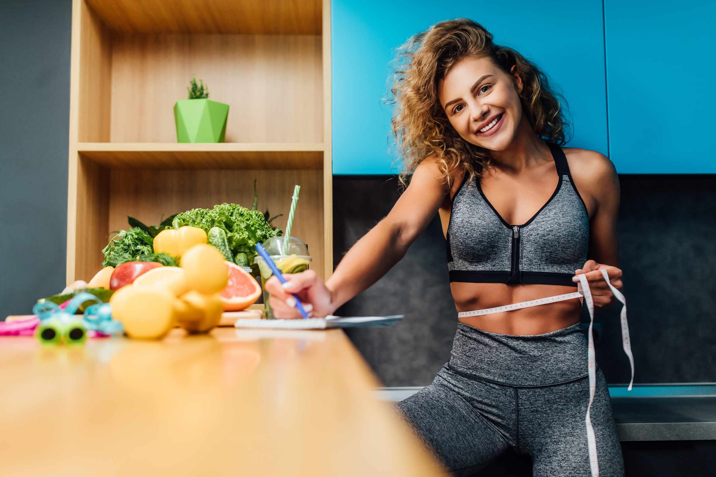
PROFILE:
Name: Hannah.
Age: 23.
Education: She has a high school diploma in Arts and music performing arts, with a course in modelling workshop from New York Fashion Institute.
Profession: Model and Youtuber with 1M subscribers..
Interests: Hannah enjoys exercising, yoga, attending fashion workshops, shopping and painting.
Difficulties: It is difficult for her to find work that pays well, dealing with criticism, and managing her time and finances.
Goals: Being a public figure, Hannah decided to maintain proper health along with a healthy and nutrition diet. She wants to be a role model in her pursuing career.

Slide 23
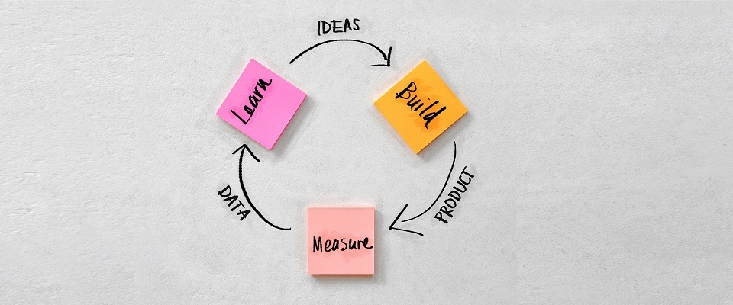
MINIMUM VIABLE PRODUCT

Slide 24
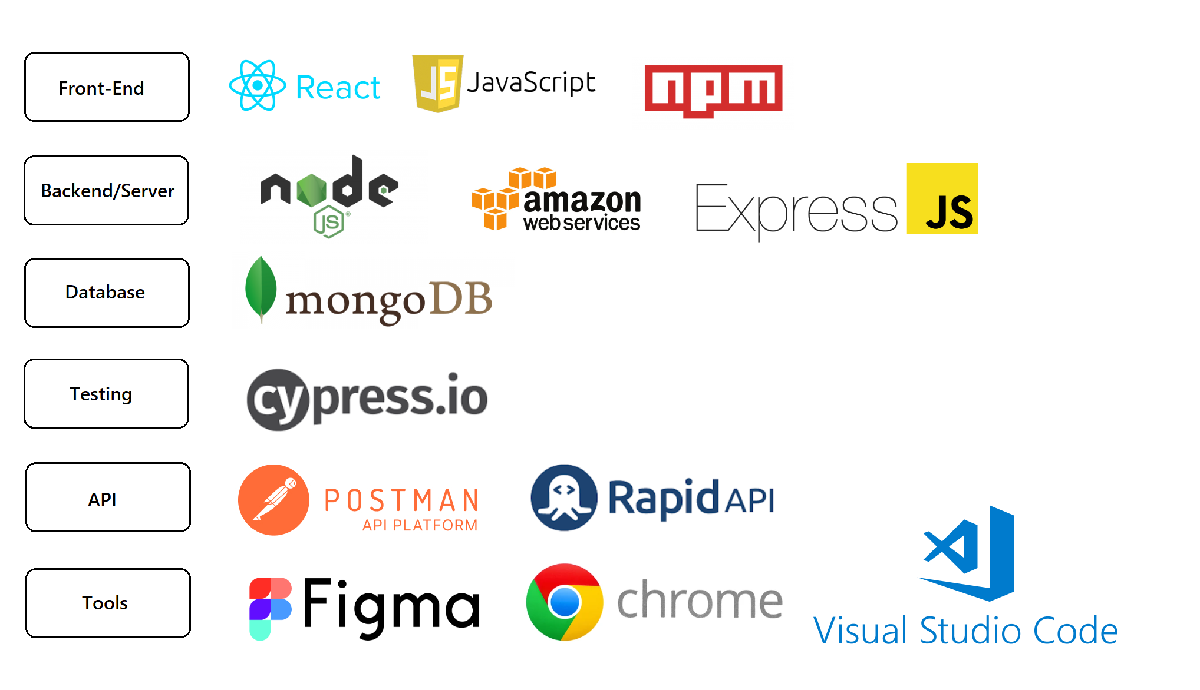
TECHNOLOGIES

Slide 25
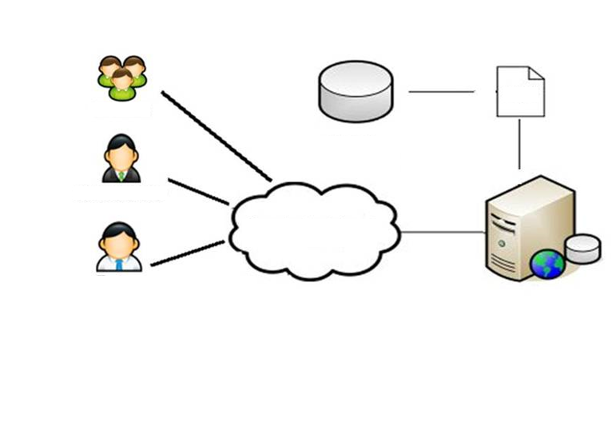
DIAGRAMS

Slide 26
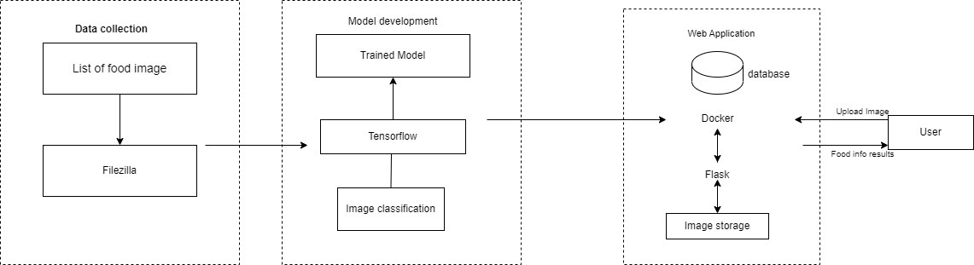
ARCHITECTURAL DIAGRAM

Slide 27
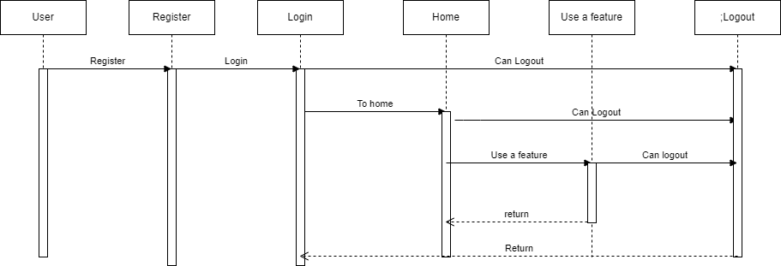
SEQUENTIAL ARCHITECTURAL DIAGRAM

Slide 28
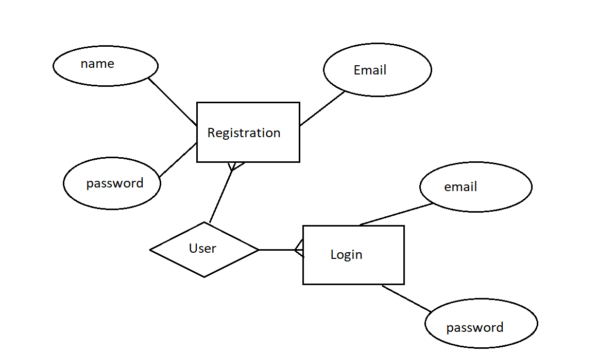
ER DIAGRAM

Slide 29
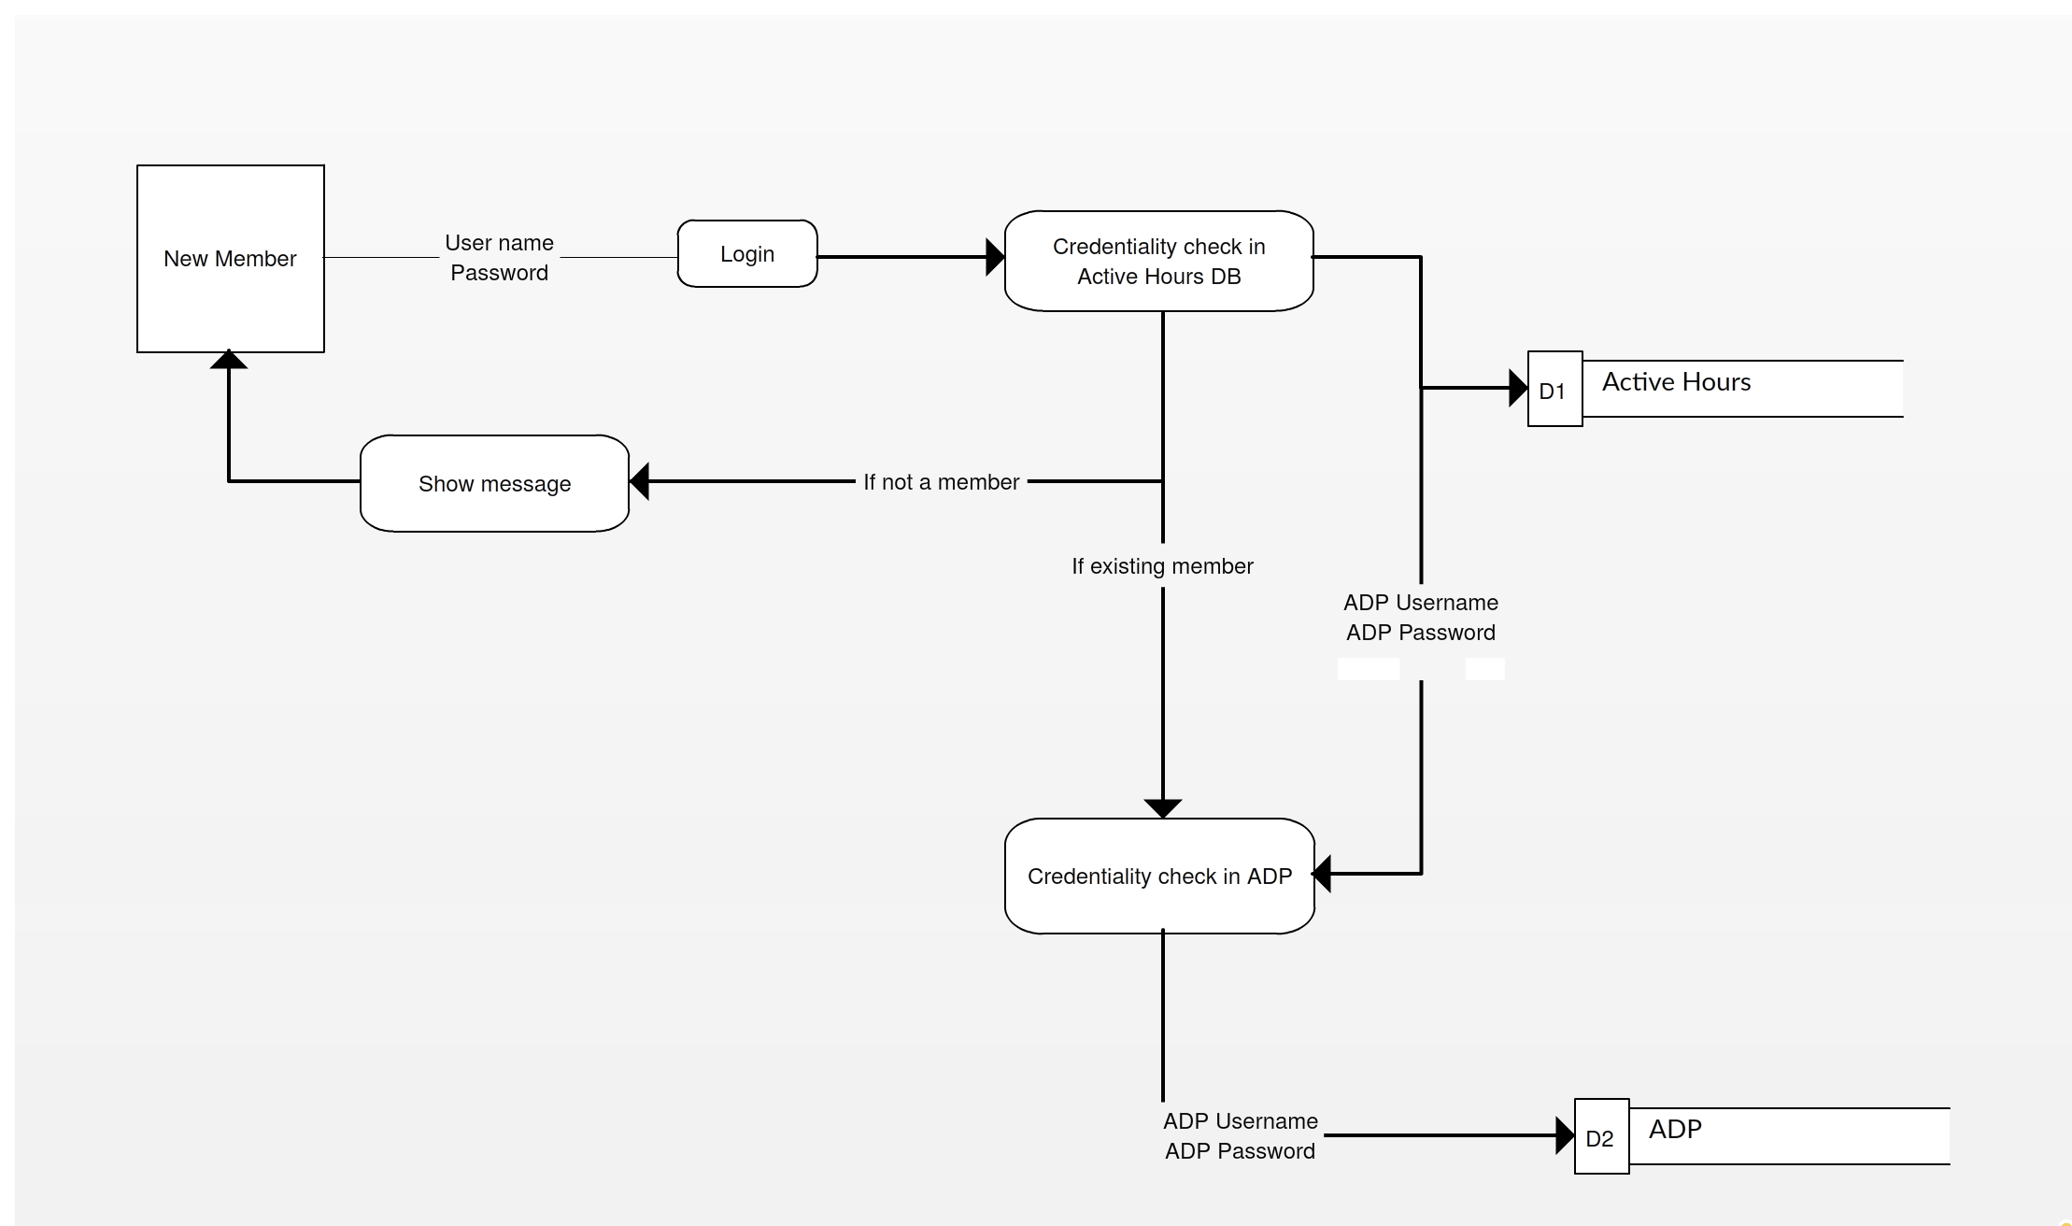
DATA FLOW DIAGRAM

Slide 30
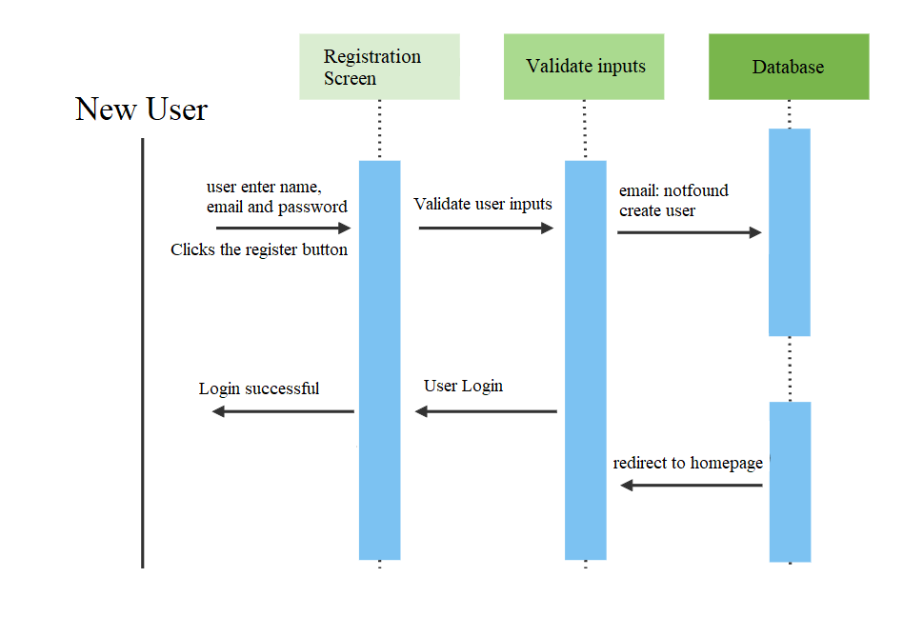
USER SEQUENCE DIAGRAM FOR NEW USER

Slide 31
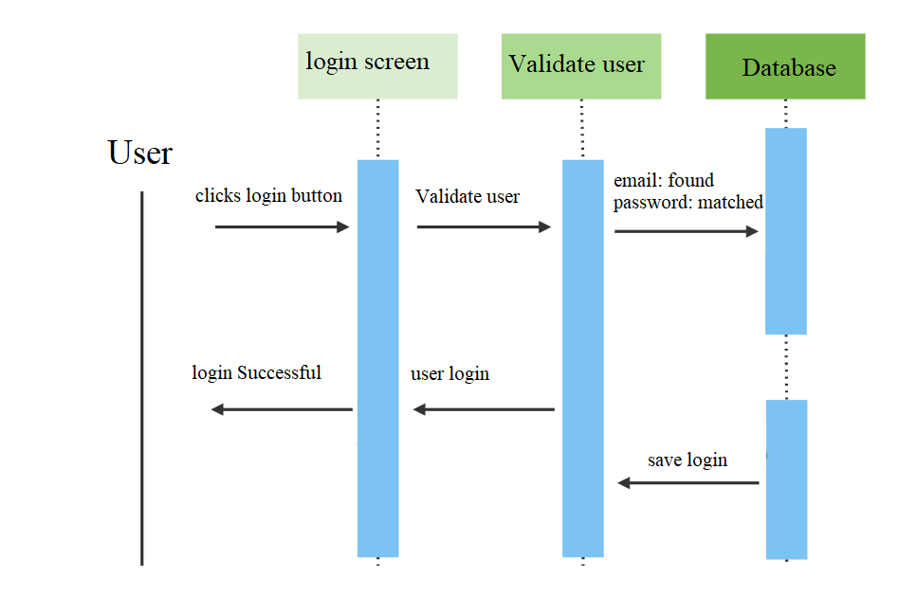
USER SEQUENCE DIAGRAM FOR EXISTING USER

Slide 32

SPRINT 4 RECAP

Slide 33
SPRINT 4 RECAP
Working on the tech paper.
Created a Sign/Login Page.
Added features for the Application
Worked on more user stories
Design backend & working on Database.

Slide 34
PRODUCT BACKLOG

Slide 35
^SAT-11 As a new user I want to navigate through home page, features, about and contact
^SAT-12 As a user I should be able to scroll though the website and see all the features in it
^SAT-13 As a user I should navigate to all the features i.e., food classification, recipe generation, balanced diet and calorie estimation
^SAT-14 As a User I should be able to contact the by writing name, feature name and email and submit when I click submit button
^SAT-15 User can log out from the webpage by a single click
PRODUCT BACKLOG

Slide 36
STORIES PLANNED FOR SPRINT 5
Working on the tech paper.
Add more features to the application
Working on the Application Documentation
Complete Product Backlog for last sprint
New stories that are planned for next sprint

Slide 37
SPRINT BACKLOG & USER STORIES

Slide 38
User Stories for the Sprint
Id | Test Cases | User Stories
SAT-9 | As a user​ I want to click features So that I navigate to features section | scenario when user wants to navigate to features section Given he click features button Then the system opens the features section​
SAT-10 | As a user​ I want to click about So that I navigate to features section | scenario when user wants to navigate to about section Given he click about button Then the system opens the about section
SAT-11 | As a user​ I want to click contact So that I navigate to features section | scenario when user wants to navigate to contact section Given he click contact button Then the system opens the contact section
SAT-12 | As a user I want to click logout So that I can log out of the website | scenario when user wants to logout Given he logout Then his information gets deleted

Slide 39
TEST CASES

Slide 40
Test Id | Test Unit | Test Description | Test data | Expected output | Test result
SAT-1 | Register | User registers with email and password | Email:test1@gmail.com Password:Test1@123 | User Successfully registered | Pass
SAT-1 | Register | User registers with email and password | Email:test1@gmail.com Password:Test1@123 | User already exist with same username | Pass
SAT-3 | Register | User registers with email and password | Email: test Password:Test@123 | Email Invalid | Pass
SAT-1 | Register | User registers with email and password | Email:test2@gmail.com Password:test12 | Password should contain minimum of 8 characters | Pass
SAT-1 | Register | User registers with email and password | Email:test2@gmail.com Password:test1234 | Password should contain lower and uppercase letters and special character | Pass
SAT-2 | Login | User Logins with email and password | Email:test1@gmail.com Password:test1@123 | User Logged in successfully | Pass
SAT-2 | Login | User logins with email and password | Email:test2@gmail.com Password:test1@123 | Invalid email | Pass
SAT-2 | Login | User logins with email and password | Email:test1@gmail.com Password : test2@123 | Invalid password | Pass
SAT-5 | Home | User navigates through the catalogue of features | Email:test1@gmail.com Password : test2@123 |  | Pass
SAT-5 | Home | User clicks on service catalogue and finds about features | Email:test1@gmail.com Password : test2@123 | User finds about what these features are capable of | Pass
Test case for sign-up

Slide 41
Test Id | Test Unit | Test Description | Test data | Expected output | Test result
SAT-6 | Features | User clicks each feature and is directed to more details of that feature |  | The more details of the feature is displayed | Pass
SAT-5 | Home | User clicks About |  | Opens about section | Pass
SAT-9 | About | User clicks linkedIn icon |  | Redirected to website maker linkedIn profile | Pass
SAT-9 | About | User clicks instagram icon |  | Redirected to website maker instagram | Pass
SAT-19 | Contact | User enters name, feature name and message | Name: name test1 Feature: featurename1 Message: can you tell me more | Your message has been successfully sent | Pass
SAT-19 | Contact | User enters name, feature name and message | Name: Feature: featurename1 Message: can you tell me more | Please enter your name | Fail
SAT-19 | Contact | User enters name, feature name and message | Name: name test1 Feature: Message: can you tell me more | Please enter the feature | Fail
SAT-19 | Contact | User enters name, feature name and message | Name: name test1 Feature: featurename1 Message: | Please enter the message | Fail
SAT-5 | Home | User clicks the sign out button to log out |  | You have logged out of the website | Pass

Slide 42
STORIES COMPLETED

Slide 43
STORIES COMPLETED
^SAT-1 As a new user I want to register using email and create password
^SAT-2 As a new User if I enter wrong Invalid e-mail, I want to get an alert
^SAT-3 As a new user I should be able to add my contact details
^SAT-11 As a User I want to get informed when I enter invalid password so that I can enter correct one
^SAT-9 User could recover his password in case if he/she forgot his password
^SAT-10 User can choose a security questions to retrieve his account information
^SAT-4 As User I want to enter his information like age, height, weight, activity status so that I can get recommendations based on my Inputs
^SAT-5 As a User I want to navigate to all the services listed in the application so that I become familiar with the application

Slide 44
User Stories for the Sprint
Id | Test Cases | User Stories
SAT-1 | As a new user​ I want to register using email​ So that I can login to the application | Scenario when user wants to register​ Given he registers​ Then his information gets stored​ And he can login using email and password
SAT-03 | As a new user​ I want to login to the application, but I enter wrong credentials​ So that I get alerted using a popup message that my credentials are invalid | Scenario when user wants to login​ Given he enters wrong credentials ​ Then he gets notified by an alert to enter valid credentials.​ And the system asks him to enter right information
SAT-4 | As a new user I want to enter inputs like age, height, weight ,activity so that I get recommendations based on my information | Scenario when user wants to give inputs Given he gives inputs and press submit Then his information gets stored And The system displays his information
SAT-06 | As a new user ​ I want to navigate using a search on the web page​ So that I can navigate quickly | Scenario when user wants to navigate quickly​ Given he uses search-bar on top of the application​ Then he can navigate quickly using search-bar

Slide 45
METRICS

Slide 46
TEAM VELOCITY CHART
Number of stories planned

Slide 47
TEAMS HISTORICAL VELOCITY (AVERAGE)
Story point

Slide 48
BURN DOWN CHART
Story Point
Dates

Slide 49
COMPLETED/COMMITTED RATIO

Slide 50

RETROSPECTIVE

Slide 51
What went well?
Meetings went according to the scheduled manner and the team members complemented each other well.
Priorities were clear and members took them into account.
The collaboration was great in our paired sessions.
We were able to produced the new and challenging project proposal.
We tried to finish the deliverable on time
We worked on Mongo DB.

Slide 52
What didn’t go well?
Took more time to work on the login page.
We need to add more user stories ideas.
User Stories late in the sprint.
Took time because we worked on new technologies
A deadline on when things need to be completed and getting updates on it in every meeting was not met.
Tried hands-on on the technologies that we have decided.

Slide 53
What we did to improve?
Need to improve time-management and spend more time to work on task to avoid last minute hassle.
Tried to stay committed to deadlines and improve communication between teammates.
Complete working on the MVP and start focusing on sprint 3.
Each members need to take initiative and work on the deliverable .
Research on deep learning algorithms and learn how to do Integration.

Slide 54
SPRINT 6

Slide 55
Id | Acceptance criteria | Summary
SAT-5 | As a new user I want to navigate to all the services in the application So that I get familiar with all the services of the application | Scenario when user wants to navigate Given he wants to get familiar with all the services in the application Then user can get to know all the services in the application
SAT-9 | As a user I want to reset my password if I forgot one So that I can login again | Scenario when user forgets his password Given he changes his password Then the system stores his new password And he can login with his new password
SAT-8 | As a new user I want to edit my personal information So that I get recommendations based on changed information | Scenario when user want to edit his information Given the customer navigates to information. Then he changes his information. And he submits the information.

Slide 56

APPLICATION SCREENSHOTS

Slide 57
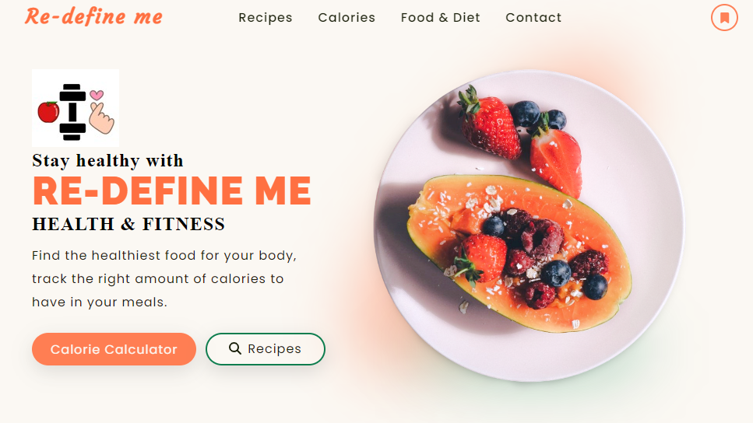
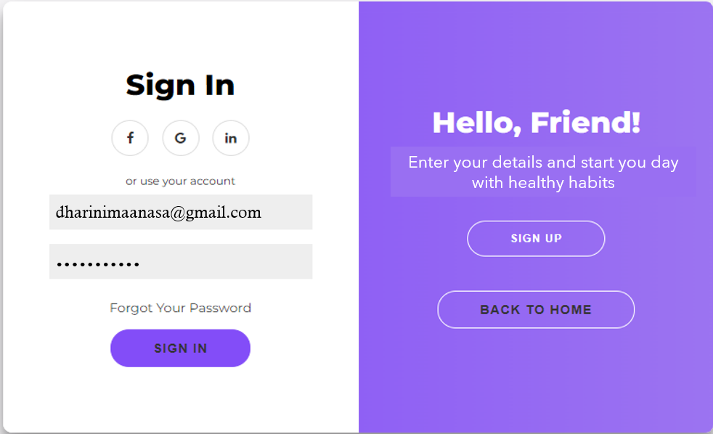

Slide 58
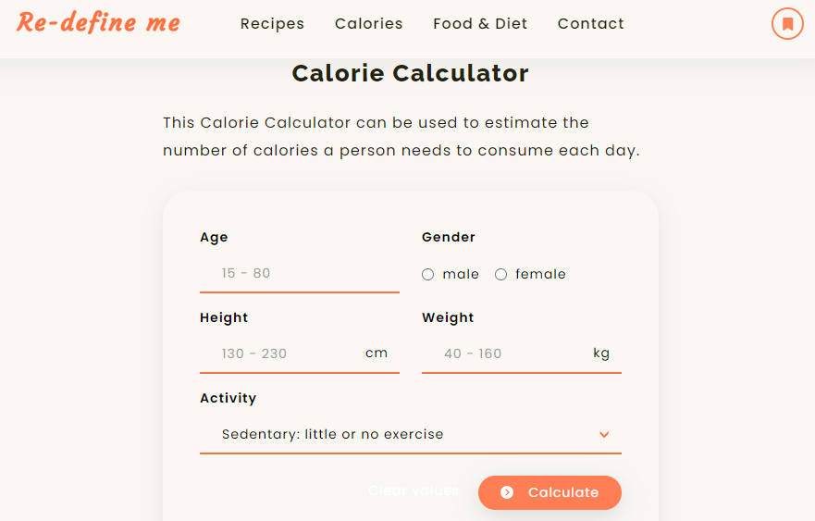

Slide 59
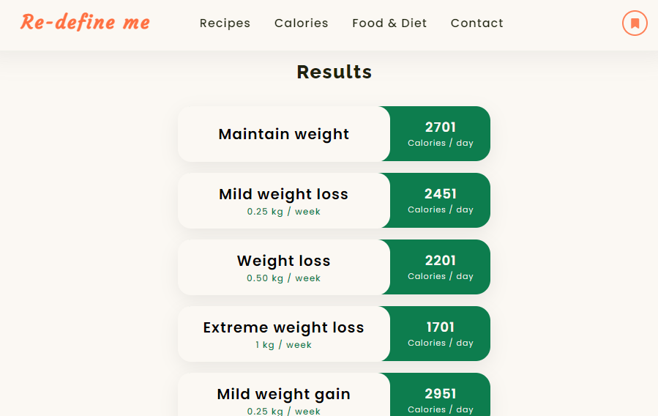

Slide 60
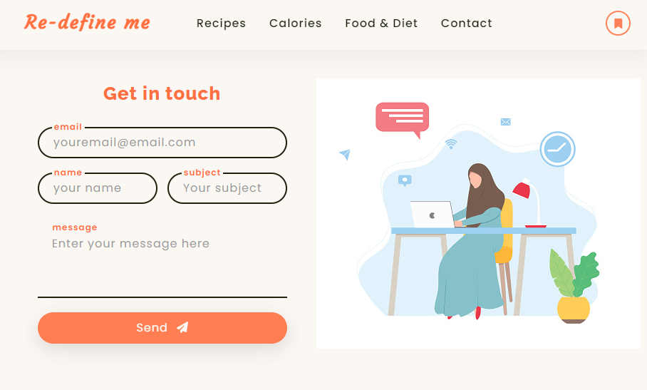

Slide 61
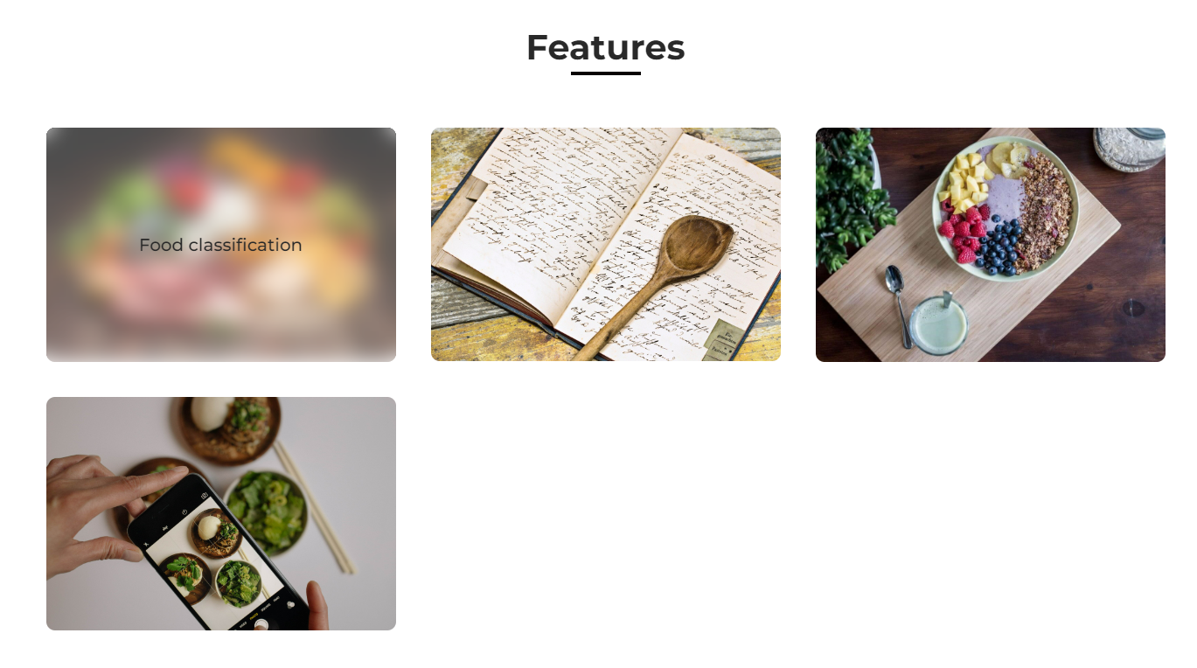

Slide 62

Git-hub Link
https://github.com/DhariniMansi/CS691.wiki.git

Slide 63
Happy eating
THANK YOU

